Slide 1



Nessus & Burp Suite
Presented by:
Irfanullah
M Yamin

Slide 2
Agenda
Introduction
Background
Architecture
Features
Setup & Installation
Working demo

Slide 3


Slide 4
Introduction
An open-source network vulnerability scanner
Developed by Tenable Inc.
Built using Nessus Attack Scripting Language (NASL)
NASL describes individual threats and potential attacks
It can run over 1200 checks on a given computer
Notes:
Nessus is a remote security scanning tool, which scans a computer and raises an alert if it discovers any vulnerabilities that malicious hackers could use to gain access to any computer you have connected to a network.

Slide 5
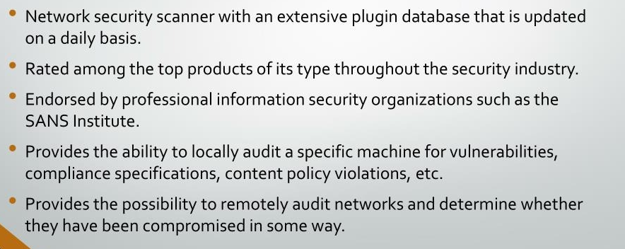
Background

Slide 6
Setup and Installation
Search "Nessus Essentials" on your browser
Go on Tenable official website
Create an account to get activation code
Download and install Nessus
Enter activation code and get started

Slide 7
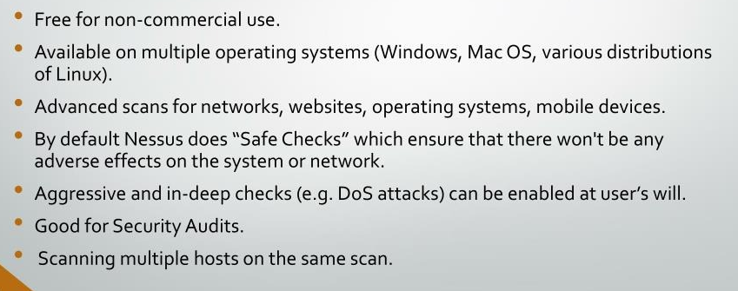
Advantages

Slide 8
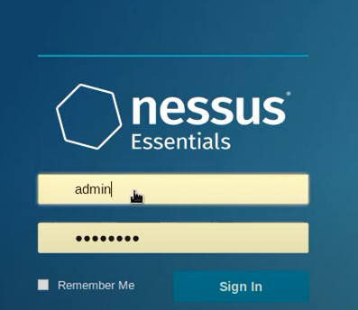
Working Demo
Create account

Slide 9
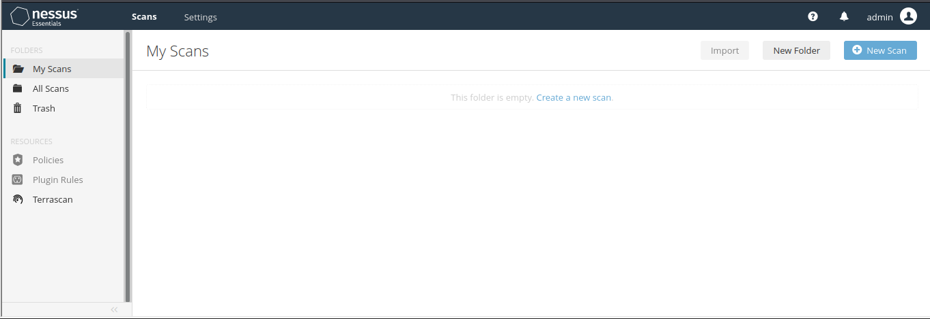
Dashboard

Slide 10
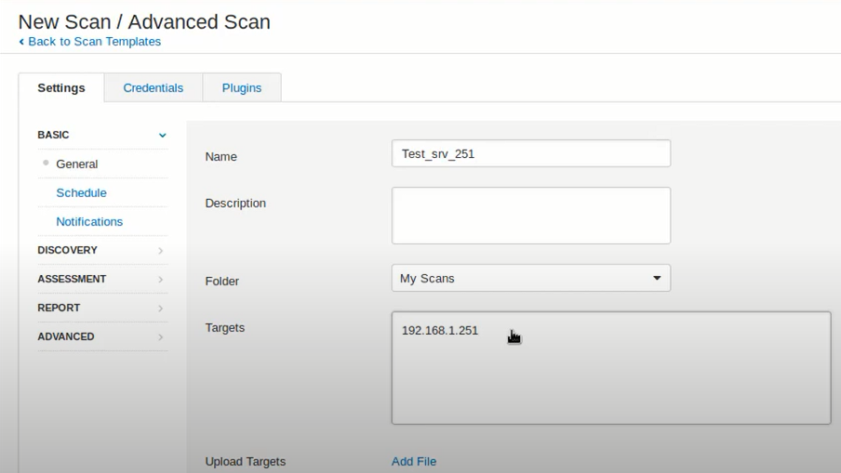
Create New Scan

Slide 11
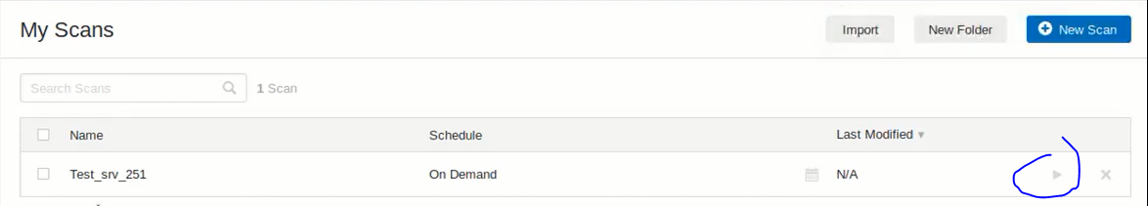
Launch the Scan

Slide 12
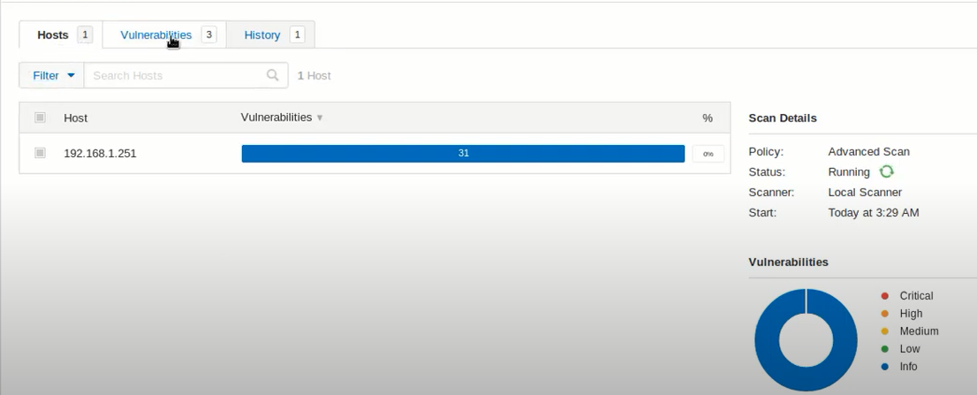
Results

Slide 13
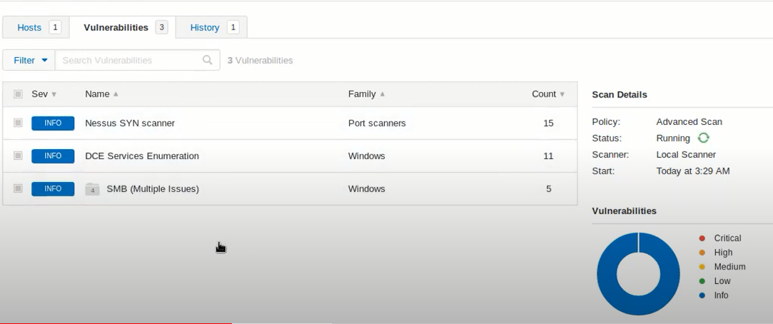
Check Vulnerabilities

Slide 14
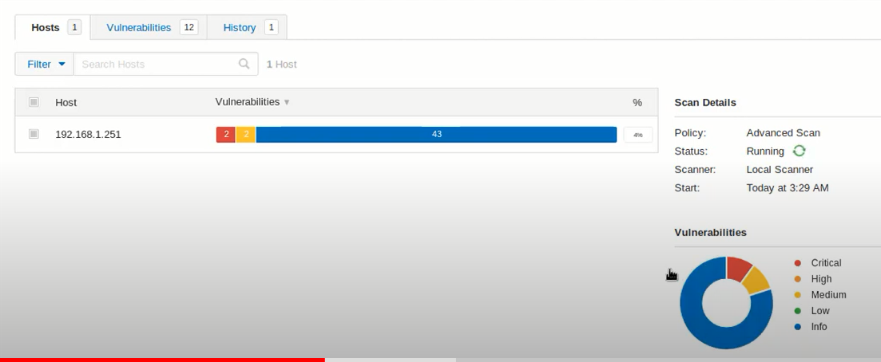
Check Vulnerabilities

Slide 15


Slide 16
Introduction
Graphical tool for performing security testing of web applications.
Support the entire testing process, from initial mapping and analysis of an application's attack surface, through to finding and exploiting security vulnerabilities.
Written in Java
Developed by PortSwigger Security.
Available in both free and professional editions.

Slide 17
Burp Suite Modules
Target
Proxy
Spider
Scanner
Intruder
Repeater

Slide 18
Target Module
Gives overview of target application’s content and functionality
It defines which targets are in scope for your current work
It drives the process of testing for vulnerabilities

Slide 19
Proxy Module
It operates as web proxy server
Man in the middle between browser and destination web servers
It lets you intercept, inspect and modify the raw traffic in both direction

Slide 20
Spider Module
It is used for automatically crawling web applications
It can be used in conjunction with manual mapping techniques to speed up the process of mapping an application’s content and functionality

Slide 21
Scanner Module
It is used for automatically finding the vulnerabilities in web applications.
Mostly used by security testers
It can fit with existing tools and techniques for performing penetration tests.

Slide 22
Intruder Module
Used for automating customized attacks against web applications
Extremely powerful and configurable
Can perform huge range of tasks from simple brute force guessing of web directories to active exploitation of complex blind SQL injection vulnerabilities.

Slide 23
Repeater Module
Used for manually manipulating and reissuing individual HTTP requests and analyzing the application’s responses.
Multipurpose tool

Slide 24
Setup and Installation
Download from PortSwinger official website
Install and import certificate from
Start scanning and Testing

Slide 25
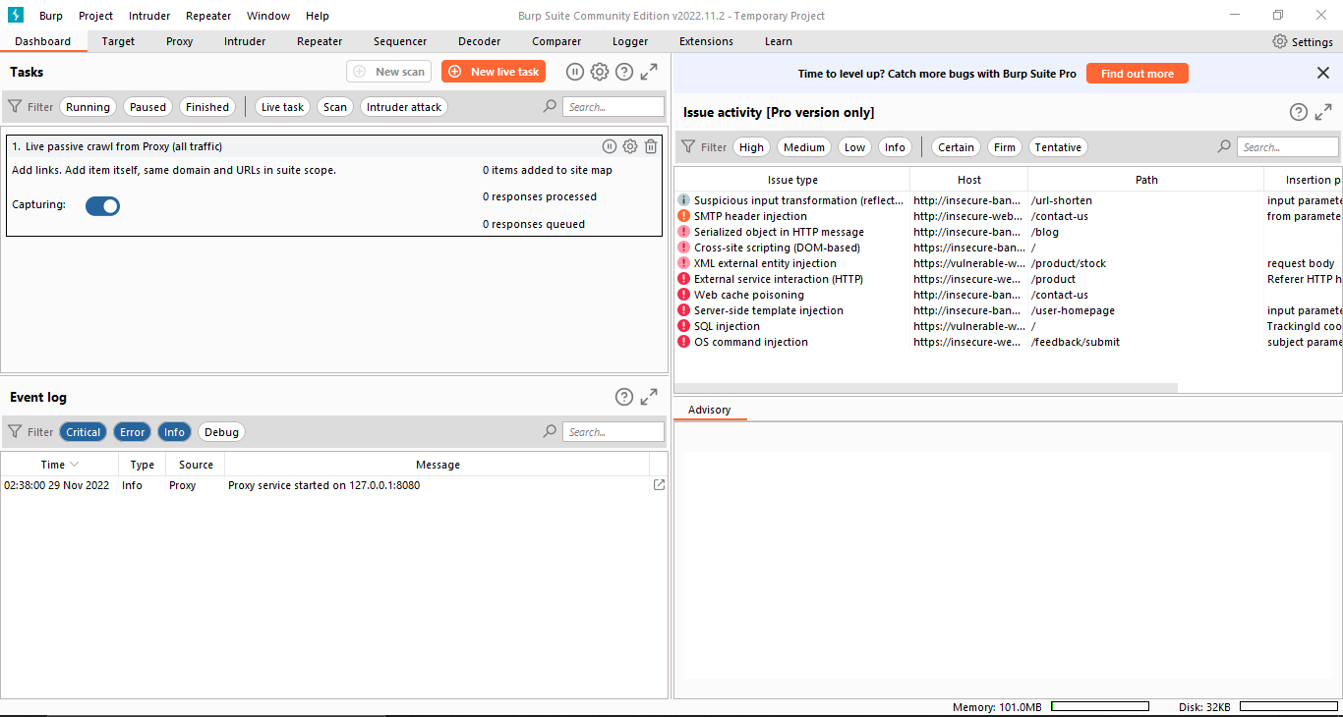
Working Demo - Dashboard

Slide 26
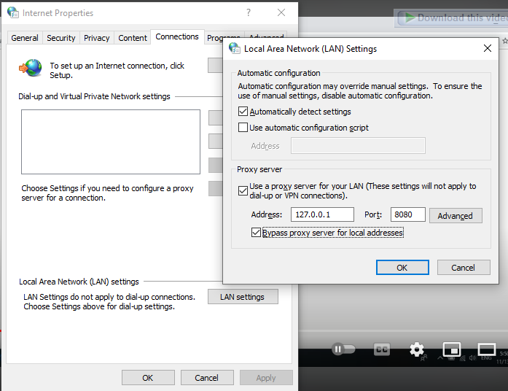
LAN Settings
Set your LAN Settings same as Burp Suite

Slide 27
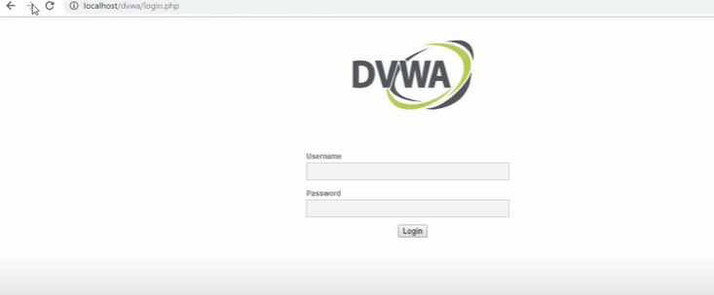
Open any vulnerable web application

Slide 28
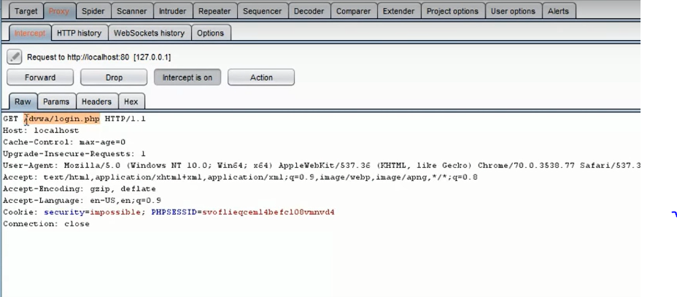
Captured Details

Slide 29
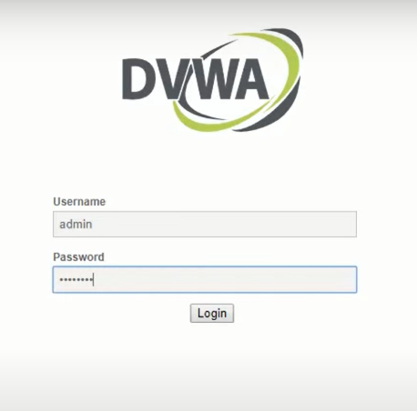
Enter some credentials

Slide 30
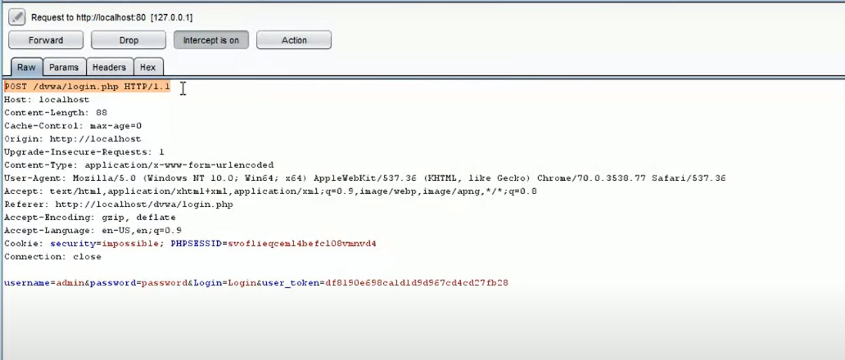
Analyze Results
Notes:
Drop or Forward Request based on analysis

Slide 31
Conclusion
Pros
Burp Suite has the most powerful tools to do web penetration testing. Burp comes with Web vulnerability scanning and fully customized scan and attack applications.
Cons
It's not easy to use, but luckily there's a lot of tutorial out there that can help the beginner to use Burp Suite.

Slide 32

That’s it !!!
Thank you.

